Slide 1
Braille for Deaf
Aman Kr Mishra - 20BCE1382
Ansh Goel - 20BCE1798

Slide 2
Abstract
  Artificial intelligence is based essentially on the creation of systems that behave and think like human beings, allowing natural communication between human beings and machines. Thanks to the evolution of man-machine communication, the use of natural communication modalities to humans has been introduced. As a consequence, it becomes necessary to convert the information between the different modalities. Several researches have been made for different types of conversions. In contrast, few researches have contemplated and examined Image to Text conversion through image metadata or prediction. So, the progression of human communication was another reason for the emergence of new applications such as car navigation aid, design aid for three-dimensional objects and especially those of learning aid whether for the assistance of the deaf and dumb people, foreign languages learners the students.

Slide 3
According to several studies, one of the causes of school failure is the student's inability to read and express himself orally and in writing and the percentage of school failure is increasing. Also, other statistical studies have shown that 86% of children learn quickly letters and sentences if they are accompanied with images. Learning aid is one of the most important fields of application of human machine communication as it presents a solution for learners . The most common sign language is American sign language. The only means of communication for D&M persons are sign languages since their single communication-related handicap prevents them from using spoken language. Our idea involves process of communicating which involves exchanging ideas and messages via a variety of means, including voice, signaling, behavior, and pictures that will be converted into text. People who are Deaf and Mute (Dumb) (D&M) use their hands to make a variety of gestures to communicate with others. With this project out is type of communication that takes place through gestures is comprehended visually. Sign language is the nonverbal form of communication used by the deaf and the dumb. In this project I basically focus on producing a model which can recognize finger spelling based on hand gestures in order to form a complete work by combining each gesture.

Slide 4
Problem Identified
Image to Text Conversion: State of the Art and Extended Work
https://www.researchgate.net/publication/323713259_Image_to_Text_Conversion_State_of_the_Art_and_Extended_Work
Unified learning approach for egocentric hand gesture recognition and fingertip detection -:
A unified convolutional neural network (CNN) algorithm for both hand gesture recognition and fingertip detection at the same time. The proposed algorithm uses a single network to predict both finger class probabilities for classification and fingertips positional output for regression in one single evaluation. From the finger class probabilities, the gesture is recognized, and using both of the information fingertips are localized.
https://www.sciencedirect.com/science/article/abs/pii/S0031320321003824

Slide 5
Proposed Solution
Sign language is one of the oldest and most natural form of language for communication, but since most people do not know sign language and interpreters are very difficult to come by we have come up with a real time method using neural networks for fingerspelling based American sign language. The only means of communication for D&M persons are sign languages since their single communication-related handicap prevents them from using spoken language. Our idea involves process of communicating which involves exchanging ideas and messages via a variety of means, including voice, signaling, behavior, and pictures that will be converted into text. People who are Deaf and Mute (Dumb) (D&M) use their hands to make a variety of gestures to communicate with others. With this project out is type of communication that takes place through gestures is comprehended visually. Sign language is the nonverbal form of communication used by the deaf and the dumb. In this project we basically focus on producing a model which can recognize finger spelling based on hand gestures in order to form a complete work by combining each gesture.

Slide 6
Contd.
Sign language is a visual language and consists of 3 major components -:
Fingerspelling -: Used to spell words letter by letter
Word level sign vocabulary -: Used for the majority of communication.
Non manual features -: Facial expression , tongue, mouth and body position.
In this project we basically focus on producing a model which can recognize Fingerspelling based hand gestures in order to form a complete word by combining each gesture.
The gestures I trained are as given in the image below.

Slide 7
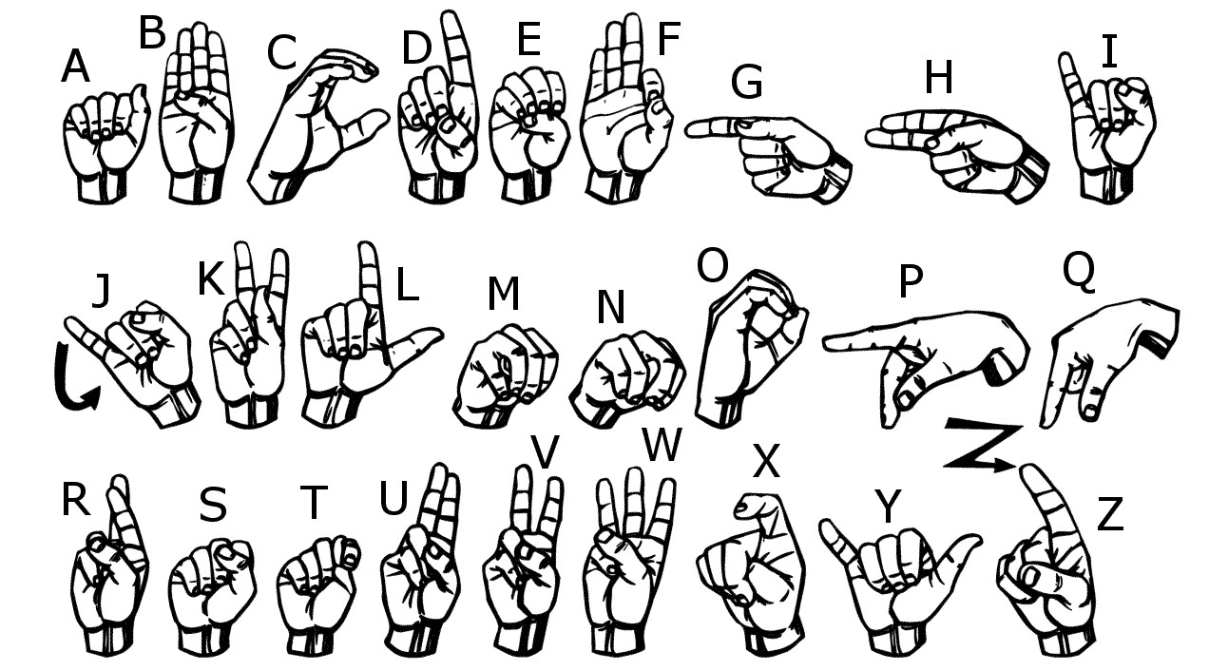

Slide 8
Technologies / Software / Hardware
To complete this project, we needed the following:
A local development environment for Python 3 with
Modern Operating System:
Windows 7 or 10
Mac OS X 10.11 or higher, 64-bit
Linux: RHEL 6/7, 64-bit (almost all libraries also work in Ubuntu)
x86 64-bit CPU (Intel / AMD architecture)
4 GB RAM
5 GB free disk space
A working webcam to do real-time image detection.
We will build a sign language classifier using a neural network. Our goal is to produce a model that accepts a picture of a hand as input and outputs a letter.

Slide 9
Why – As HCI J Comp. Project
We choose this project as it is an perfect example of Human Computer Interaction. User here who is dumb and deaf gives sign and system convert it into text. Here, As we all know Hci goal is to develop and design a computer technology which could help us to make the interaction between Human(in our case, deaf people) and the system(Computer) efficient and a lot comfortable.
So by introducing this braille for deaf people , we are making them (Computer and user) interact with the help of using a Sign language ( A type of Language) to make interaction readable and likeable. Since Hci is able to understand the human needs to the fullest we are trying to design this braille in order to understand the behavior, interest and various other stuff so that the interface that is designed is free of flaws and a smooth interconnection is maintained between the user and the system.

Slide 10
Expected Contributions / Student wise
Aman Kr Mishra - Preparing the Sign Language Classifications Dataset
Building and Training the Sign Language Classifier
Data preprocessing
Ansh Goel - Saving Models and Weights
Define Keras neural network that includes the layers
Testing

